Slide 1
UIAA Membership Drive
Jerry Xu Miranda Garza
Prathamesh Patil

Slide 2
BOOSTING MEMBERSHIP SIGN-UPS: THE ALUMNI ASSOCIATION'S MISSION
The three universities that make up the University of Illinois System have over 800,000 live alumni.
The University of Illinois Alumni Association introduced a new alumni membership program in February 2022, available to both alumni and community members.
There are currently 770 members registered with UIAA.
The program is intended to involve the community while also providing a variety of perks such as access to special events, networking opportunities, and discounts on different products and services.
The University of Illinois Alumni Association intends to expand its membership program and interact with even more alumni and community members in the future.

Slide 3
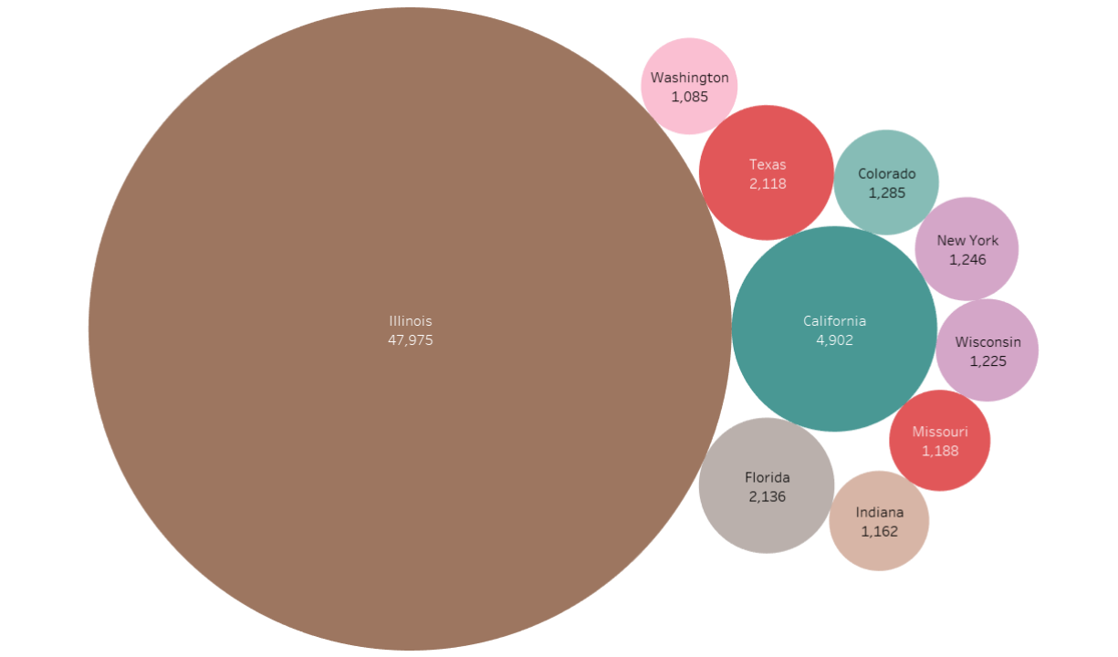
Illinois Dominates Non-Membership

Slide 4
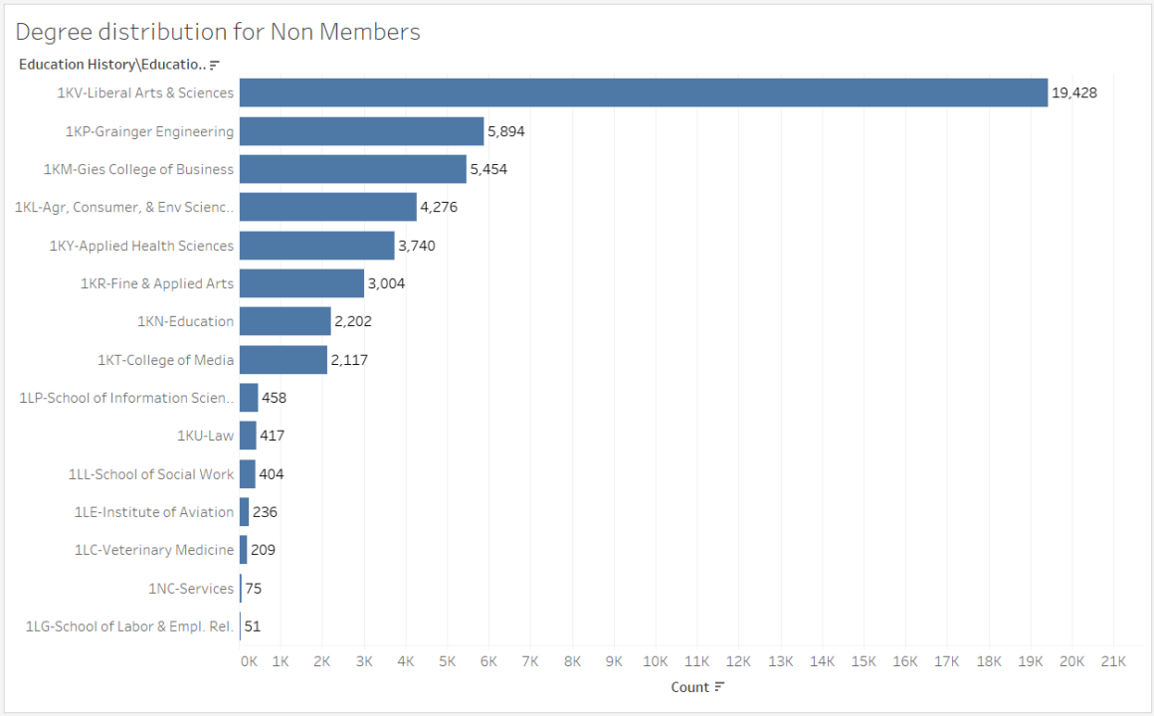
LAS, Grainger, & GIES alumni account for most
non-members

Slide 5
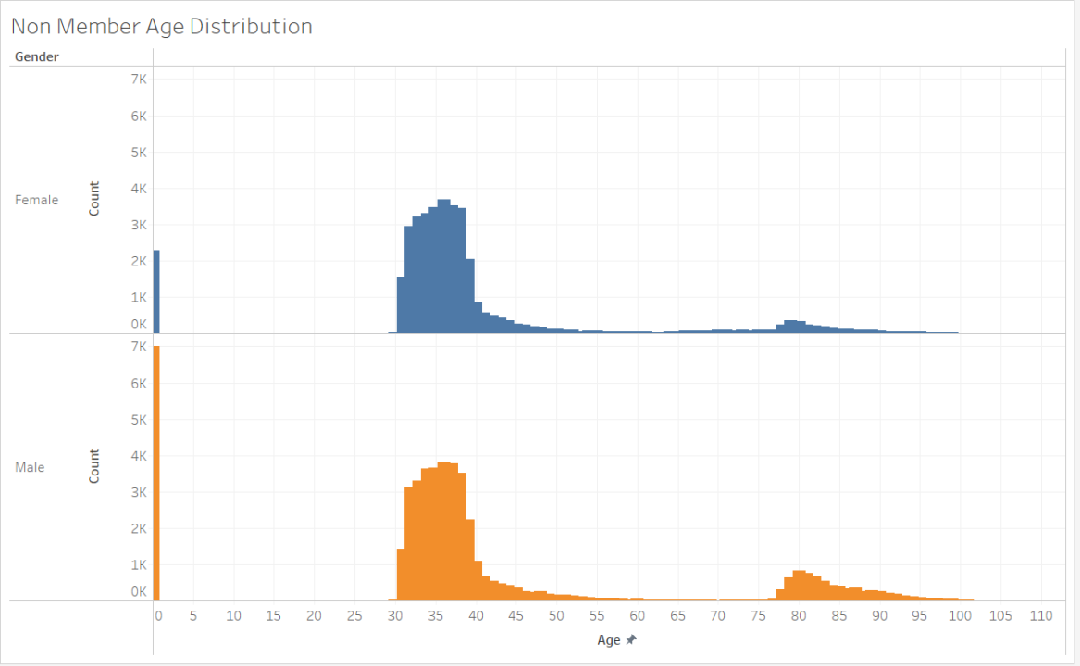
Age Group
30-45 is the
Non-Membership Majority

Slide 6
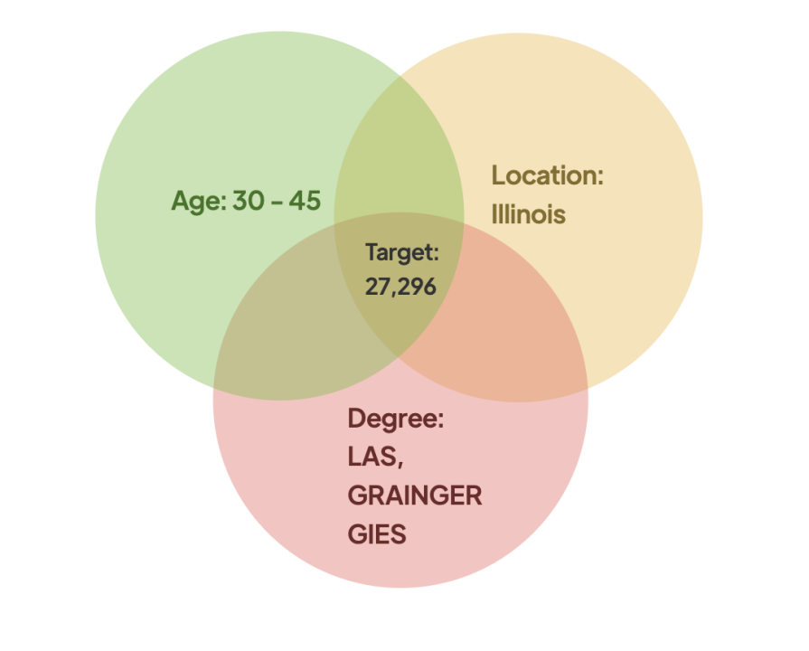
Target Segmentation Demographics
We have identified our target segmentation to be
30–45-year-old graduates of the college of LAS, GRAINGER, or GIES who live in Illinois.

Slide 7
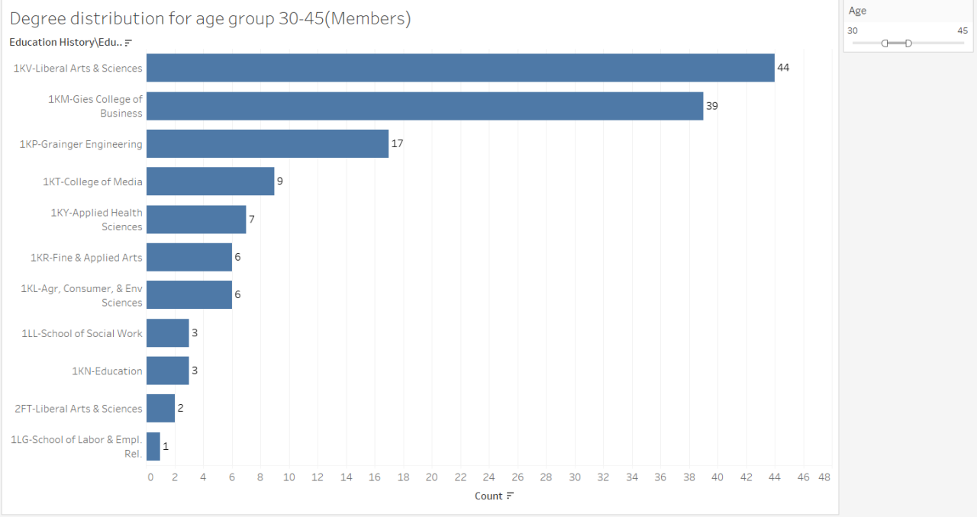
Degree Targeted Marketing Strategy
Tailor and focus promotional email campaigns to the college of GIES, GRAINGER, and LAS alumni population that fall within the targeted segmentation.

Slide 8
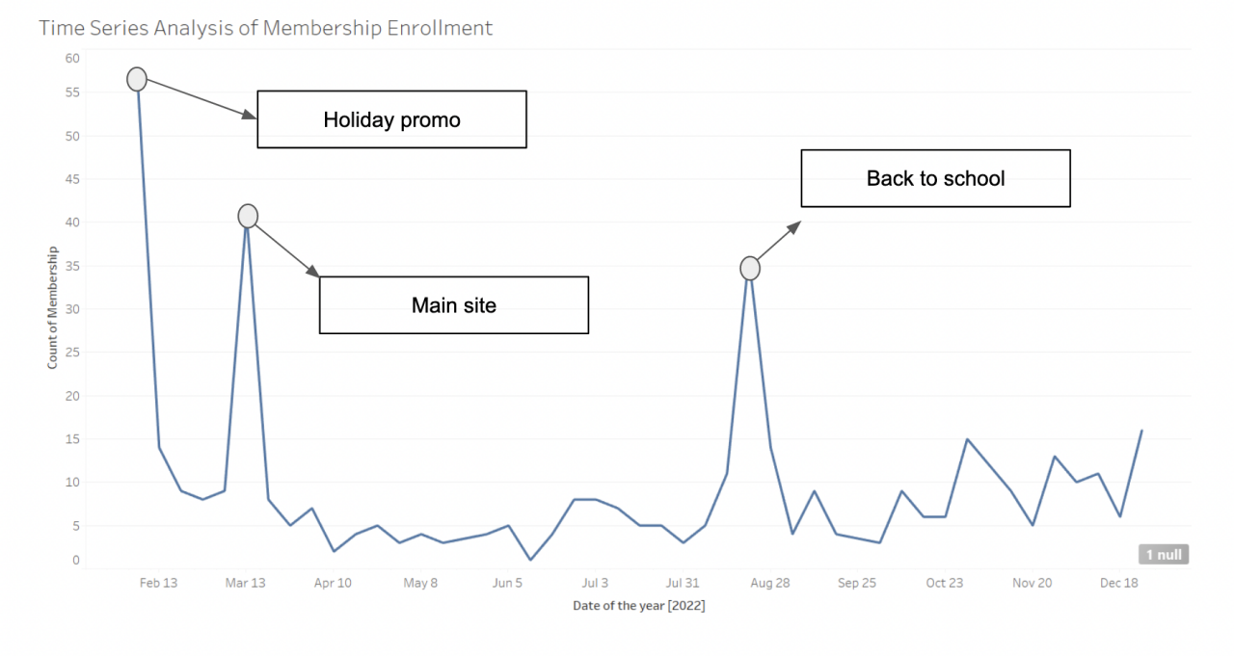
Email Campaign Timing Marketing Strategy
Promotional email campaigns are effective in increasing the number of membership sign-ups, especially during the months of February, March, and August. Campaigns should align with events that are relevant to alumni to incentivize sign-ups.

Slide 9
MARKETING PERSONAS
Based on the identified segments
Degree
Geographic Location
Age

Slide 10
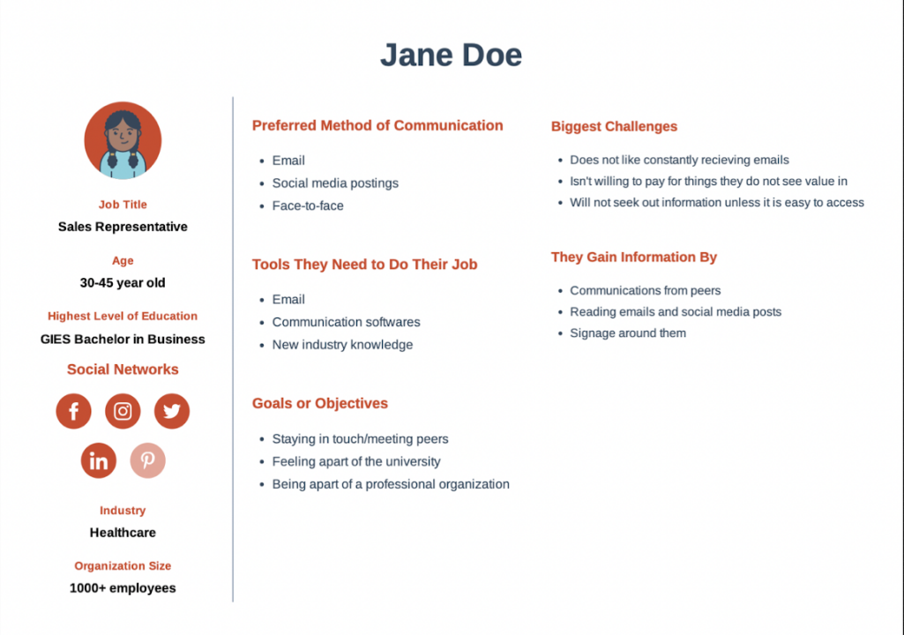
MARKETING PERSONA: AGE
In the age segment, we have found that the 30-45 age group is looking for connections with fellow alumni and the university.

Slide 11
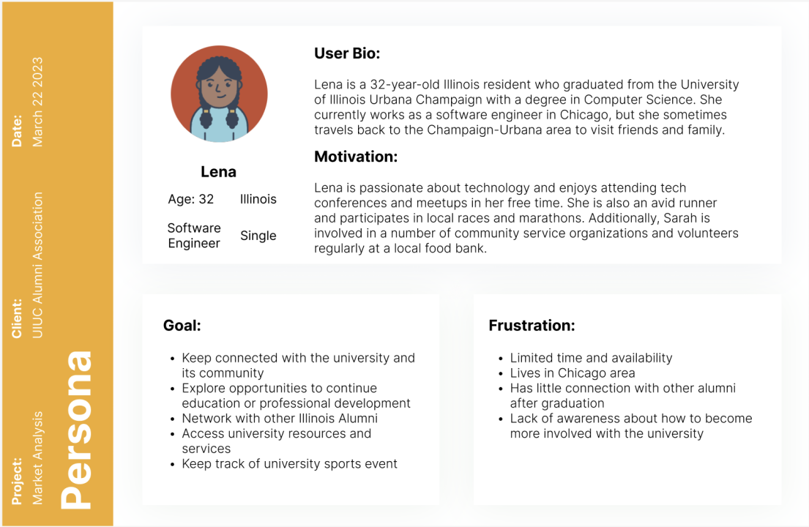
MARKETING PERSONA:
GEOGRAPHIC LOCATION
In the geographic segment, we have realized that the alumni might be struggling to keep up with university events, including speakers and sports events, because of the physical location he or she resides.

Slide 12
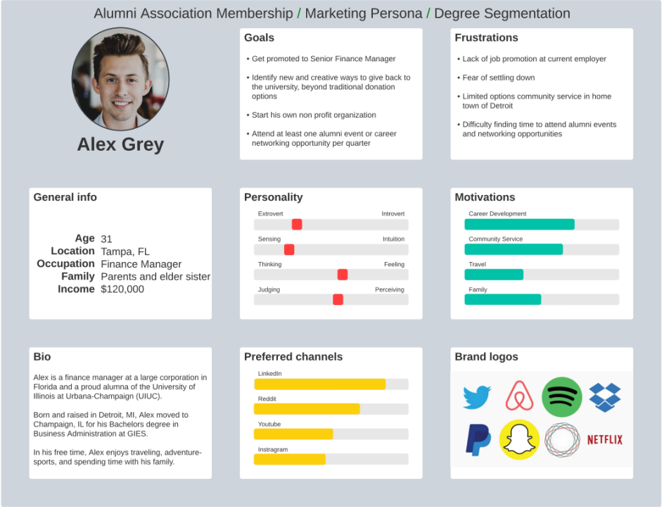
MARKETING PERSONA: DEGREE
In the degree segment, we noticed that career outcome, professional development, and networking are crucial to alumni who have studied STEM and are doing similar work.

Slide 13
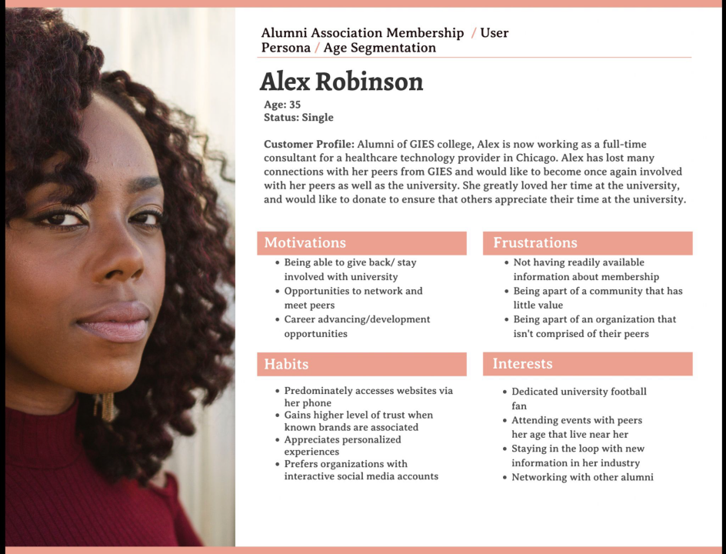
USER PERSONA
We conducted a UX Test to identify potential factors that affect the user’s ability to get information about the membership program as well as sign up for memberships.

Slide 14
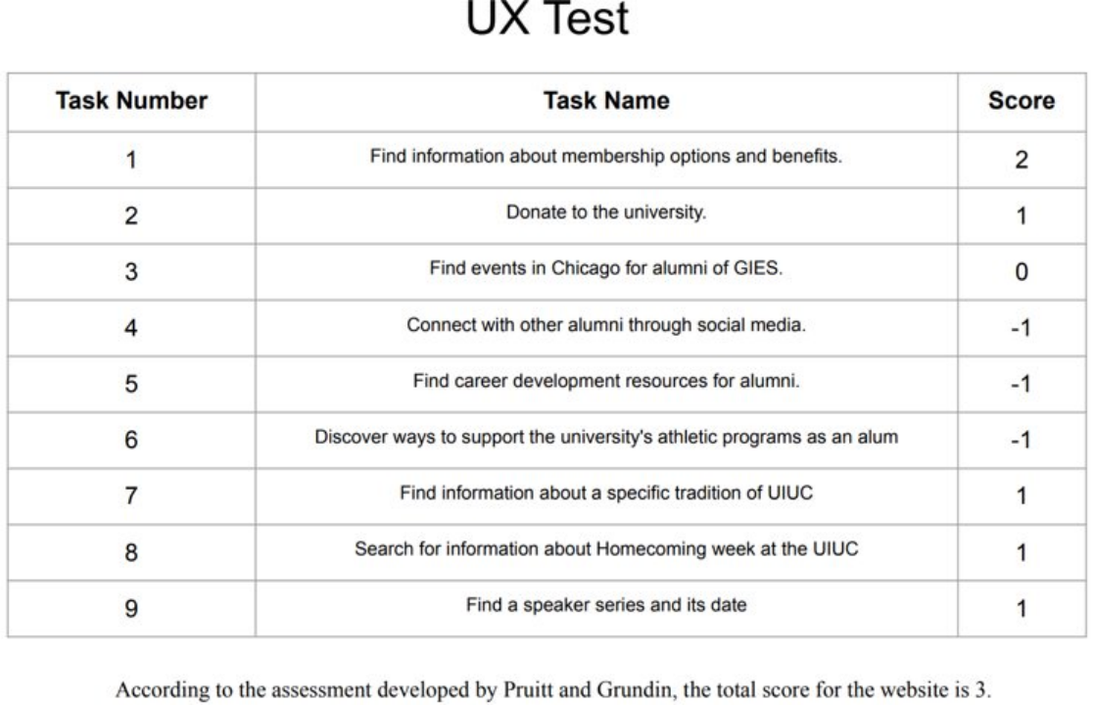
UX TEST & SCORE
Enhancing UX & Our Recommendations on Improving Three Major Areas :
Connections with other alumni through social media
Promote IlliniLink as a membership benefit
Career development resources
Create page containing all career development resources for members
Finding alumni events near member’s geographic location
Promote access to events and event calendar as membership benefit

Slide 15
PREDICTIVE MODELS
Linear Regression(Donation Amount)
Logistic Regression (If Donated)
Age
Marital Status
Gender
All variables

Slide 16
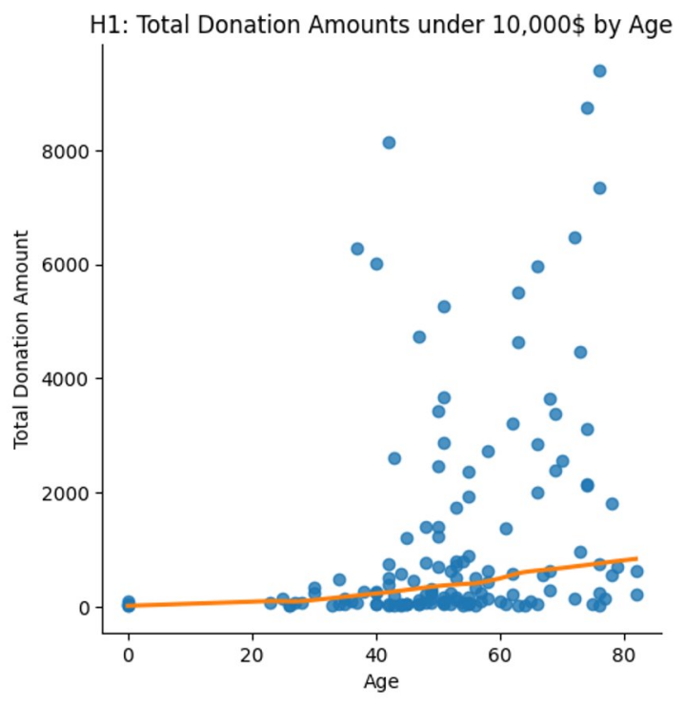
PREDICTIVE MODEL (AGE FACTOR)
Age positively correlates with the total donation amount
The R^2 value is 0.0838, which indicates that the model only explains small variances in the data
P-value = 0.028

Slide 17
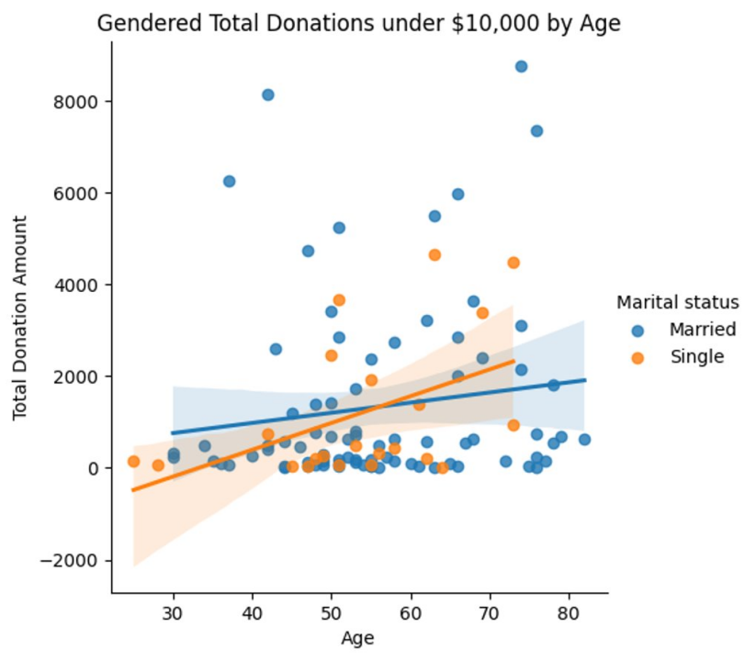
PREDICTIVE MODEL (MARITAL STATUS FACTOR)
Each marital status positively correlates with the total donation amount.
Married individuals donate more than the single individuals.
Being single has a higher correlation than being married with the total donation amount.
The R^2 value is -0.0026, which indicates that the model does not explain variance.
P-value = 0.01

Slide 18
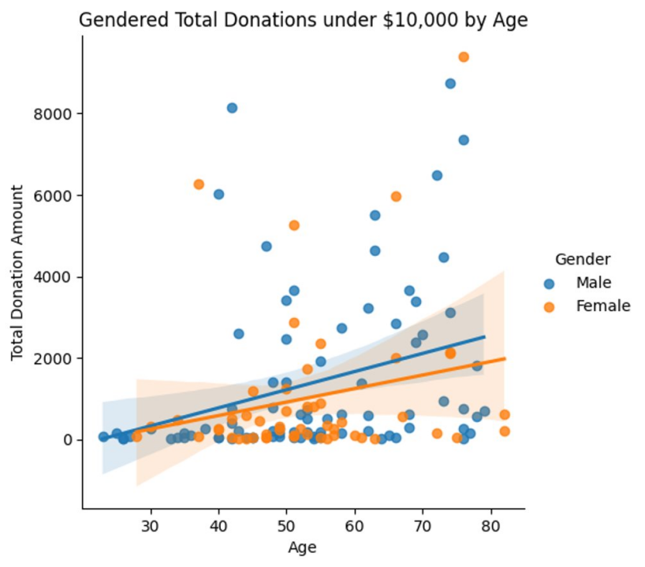
PREDICTIVE MODEL (GENDER FACTOR)
Each gender is positively correlated with the total donation amount.
Being male has a higher correlation than female to the donation amount.
The average donation amount for males is higher.
The R^2 value is 0.4038, which indicates that the model explains moderate variances in the data.
P-value = 0.042

Slide 19
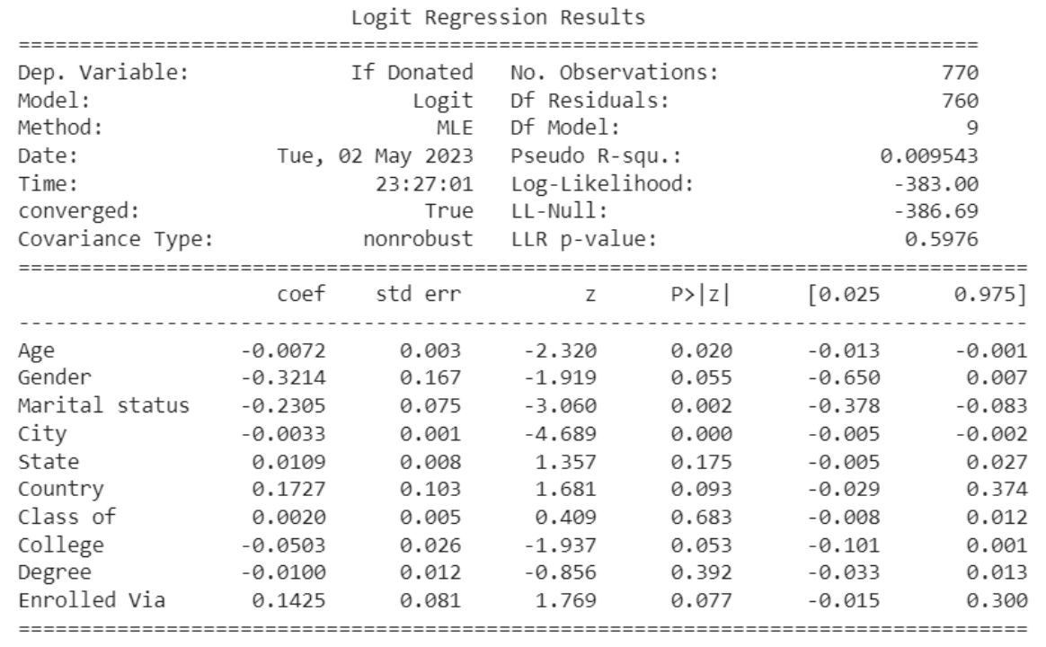
Predictive Model (Logistic Model)

Slide 20

COEFFICIENTS & CONTEXT
Age (p value = 0.02, Coeff = -0.0072)
Negative value indicates as age increases, odds that member donates decreases. For every one-year increase in value of age, odds of donation decrease by 0.7%
Gender (p value = 0.05, Coeff = -0.3214)
The coefficient value indicates that being female (female is coded as 0 and male is coded as 1) is associated with a lower probability of donating than being male. In other words, if a donor is female, there is 37% chance that they won't donate.
Marital Status (p value = 0.002, Coeff = -0.2305)
The log odds of the response variable (e.g., whether a person donated) decreases by 0.2305. Since there are 6 categories in Marital status, this coefficient applies to the effect of moving from one category to another while holding all other predictor variables constant. In simple words, as we move from left to right - Married, Single, Divorced, likelihood of donation falls by 20.58%.
The logistic regression coefficient β associated with a predictor X is the expected change in log odds of having the outcome per unit change in X.
So, increasing the predictor by 1 unit (or going from 1 level to the next) multiplies the odds of having the outcome by e^{β}

Slide 21
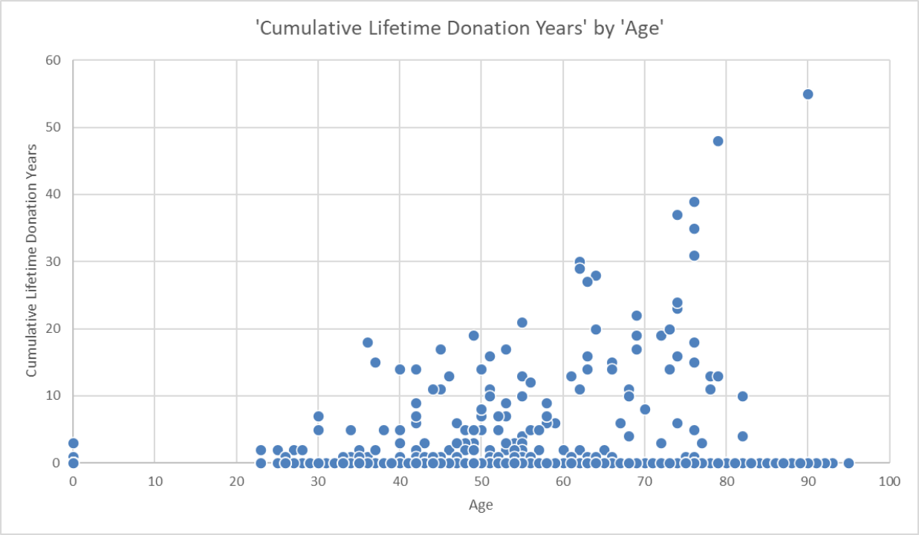
Some Donation Related Findings
Out of the total 770 members, 155 (20.13%) are donors.
Among the donors, 63 (40.64%) are aged between 30-45 years.
The sum of the donation amount by top 2 donors is $654,684.3 while the rest of the donors contributed $553,977.97
53.54% of donors (83) have donated for less than 5 years.

Slide 22





RECOMMENDATIONS
Use email as advertising strategy and promote during February, March, and August (Peak membership enrolment)
Encourage recurring donations for older (45+) and married alumni (Highest donation amount)
Target segmentation (30-45, Illinois, LAS/GRAINGER/GIES) to become members (27,296)
Improve the Alumni Association website: promote IlliniLink for alumni, career resources, and accessible events
Expand the Marketing Campaign to other universities within U of I system

Slide 23
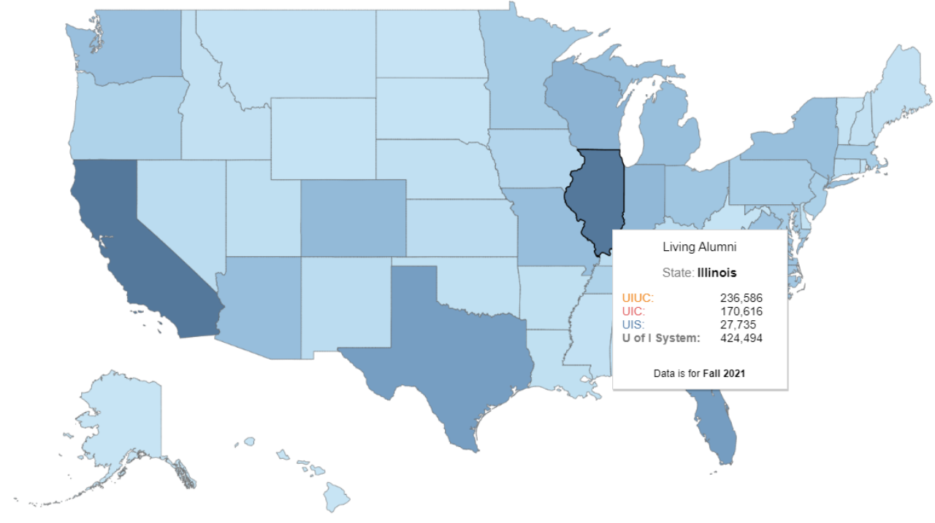
DEMOGRAPHIC HEATMAP FOR
U of I SYSTEM

Slide 24


THANK YOU!
ANY QUESTIONS?

